Slide 1
Transportation Division Data Analytics Toolkit
March 2022

Slide 2
Overview
Data Processing
Excel
Python
R
Geospatial Data Processing
ArcGIS
QGIS
Interactive Chart
Tableau
Plotly
Interactive Map
ArcGIS Online
Carto
Mapbox GL JS
Database
MS SQL Server
SQLite / SpatiaLite
PostgreSQL / PostGIS
DBeaver
Other Tools
GitHub
Visual Studio Code
Geosupport
DigitalOcean

Slide 3
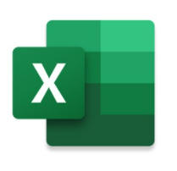
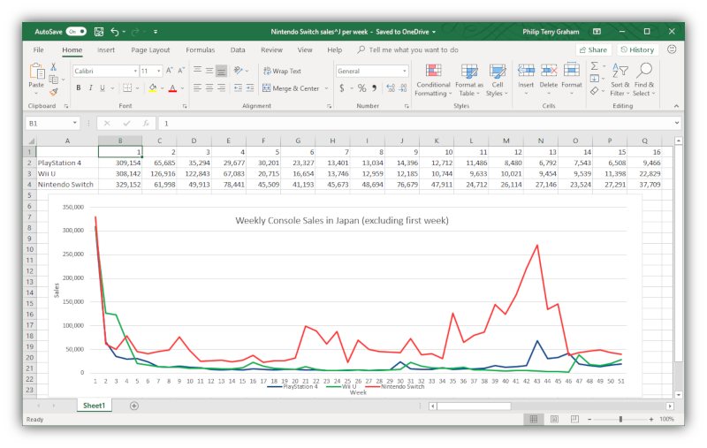
MS Excel
Data analytics software by Microsoft
Creating, reading, writing, manipulating, analyzing, and visualizing relatively small datasets
Formulas (SUM, IF, VLOOKUP, etc.)
Pivot table
Static chart / map
Data Analysis Tools
Macros with VBA

Slide 4




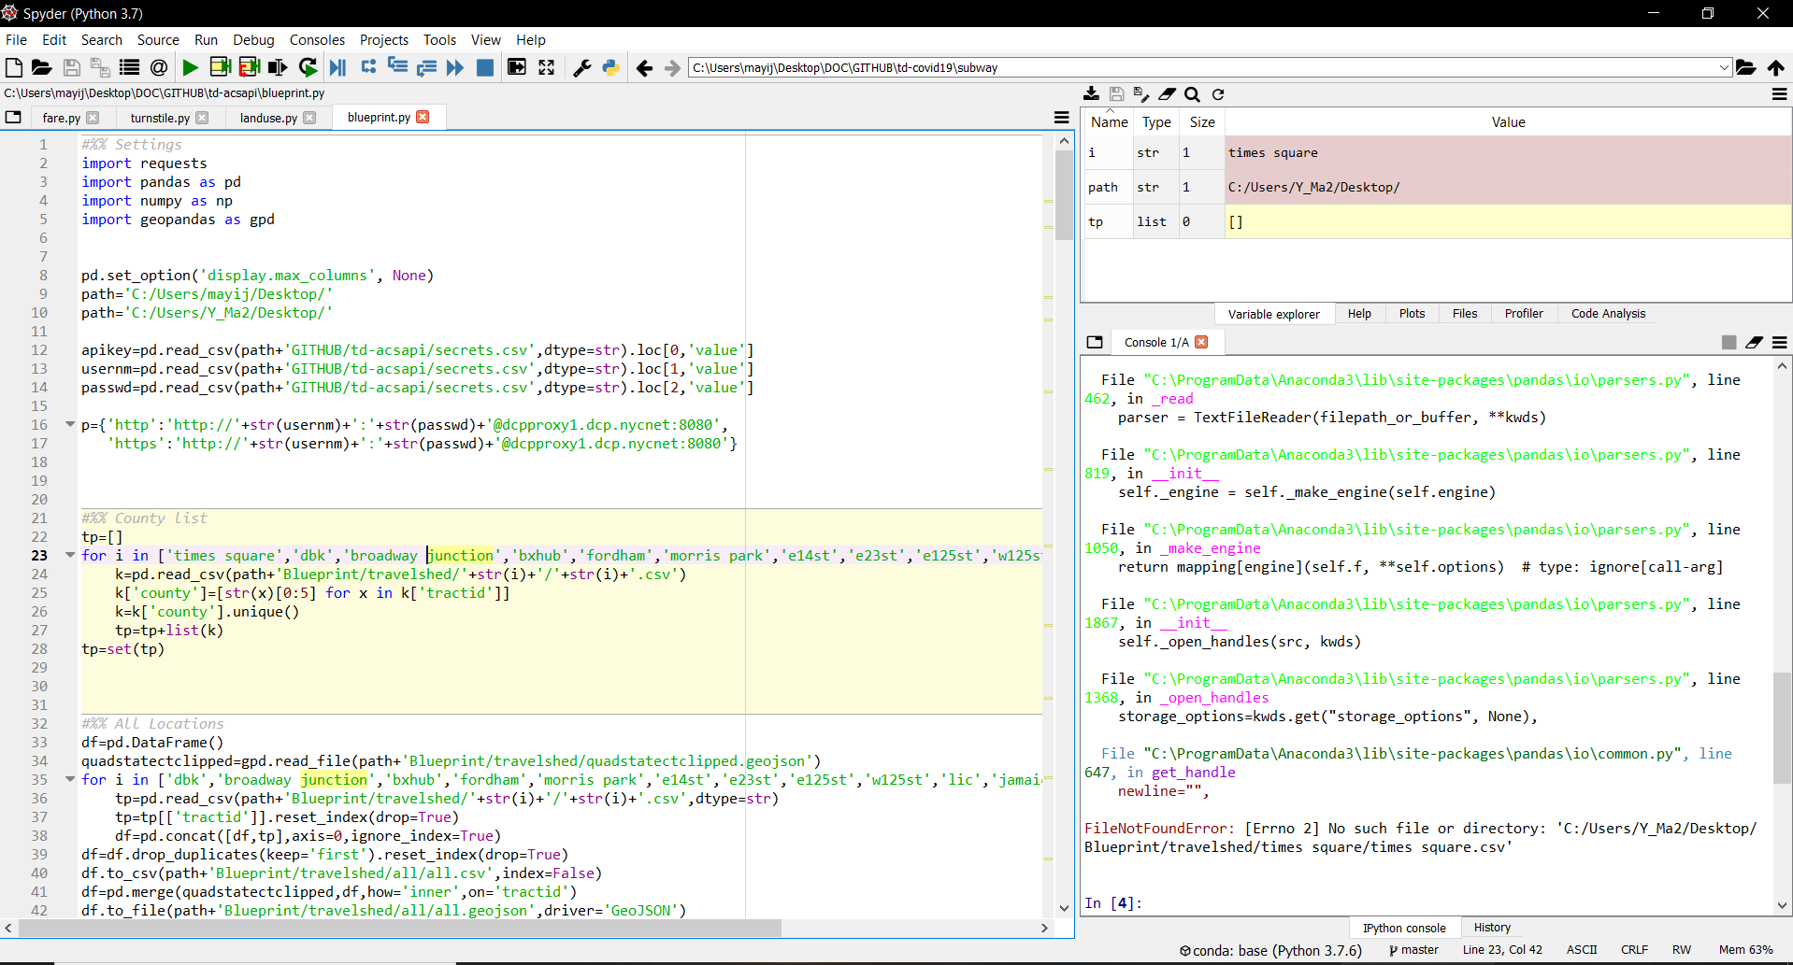
Python
Open-source general–purpose programming language
Reading, writing, manipulating, analyzing, and visualizing relatively big data
Reproducibility and transparency
IDE: Spyder / Jupyter
Data wrangling: Pandas
Spatial data: GeoPandas
Interactive visualization: Plotly
Dashboard / App: Streamlit / Dash

Slide 5


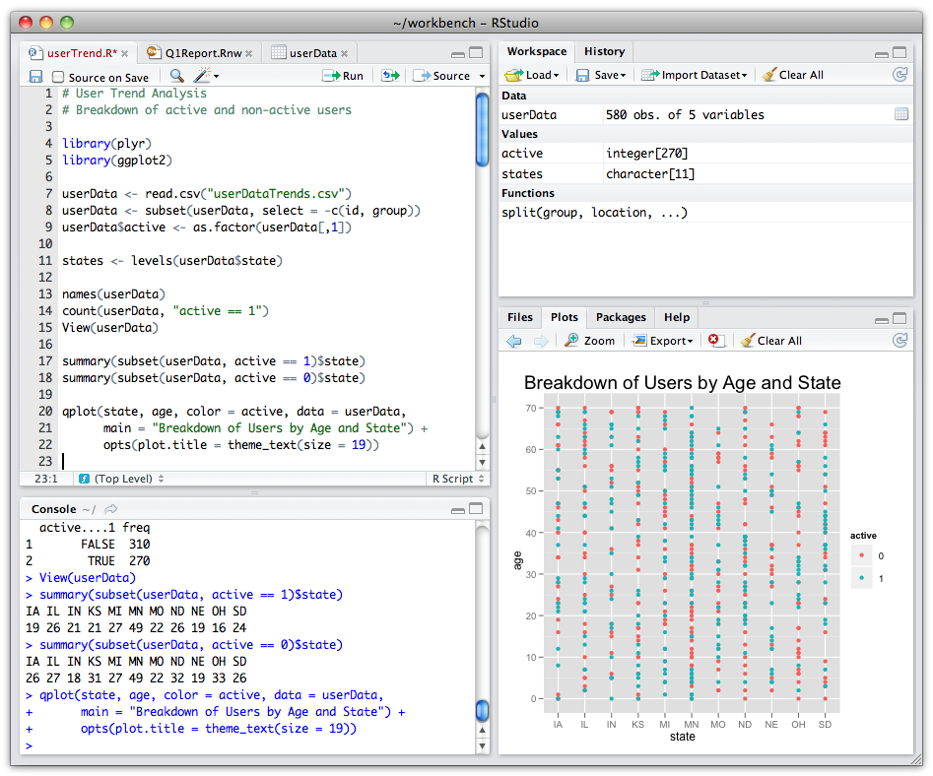
R
Open-source programming language optimized for statisticians
Reading, writing, manipulating, analyzing, and visualizing relatively big data
IDE: RStudio
Data wrangling: tidyverse (dplyr)
Spatial data: sf
Interactive visualization: Plotly
Dashboard / App: R Markdown / R Shiny

Slide 6


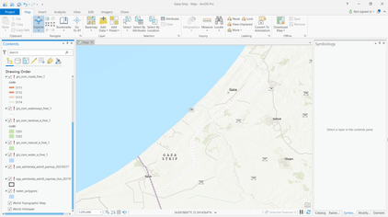
ArcGIS Desktop
Proprietary GIS software by ESRI
Creating, reading, writing, manipulating, analyzing, and visualizing geospatial data
Data format: Shapefile, Geodatabase, etc.
ArcGIS Pro replacing ArcMap

Slide 7

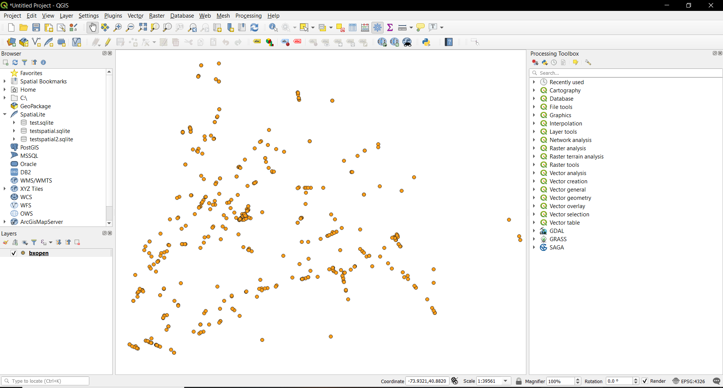
QGIS
Open-source GIS software
Creating, reading, writing, manipulating, analyzing, and visualizing geospatial data
Data format: Shapefile, GeoJSON, etc.
Toolbox and plugins for geoprocessing

Slide 8

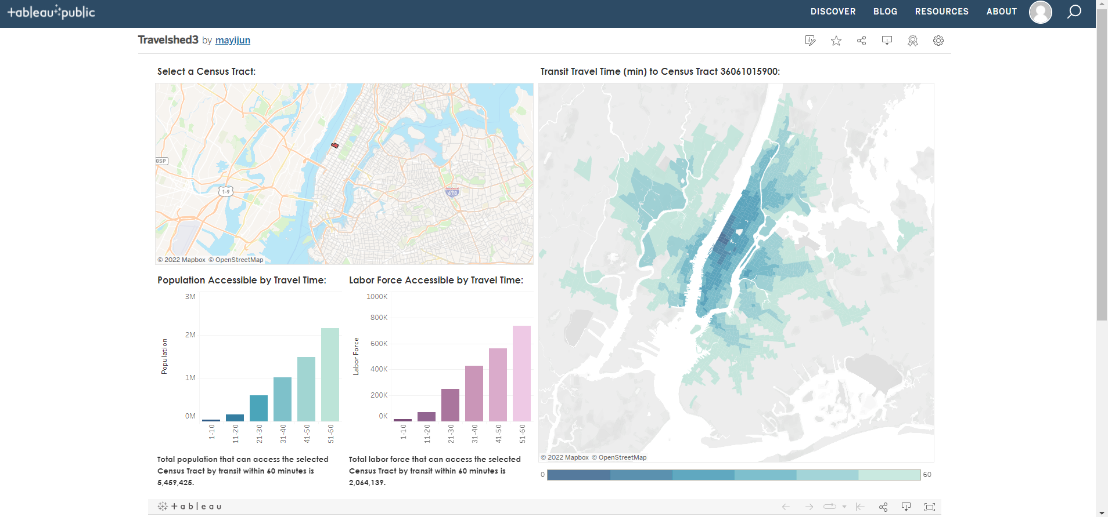
Tableau
Data visualization software owned by Salesforce
Creating dashboards with interactive charts and maps
Tableau Public (free) for completely public data visualization
Tableau Desktop / Online (require license) for non-public data

Slide 9

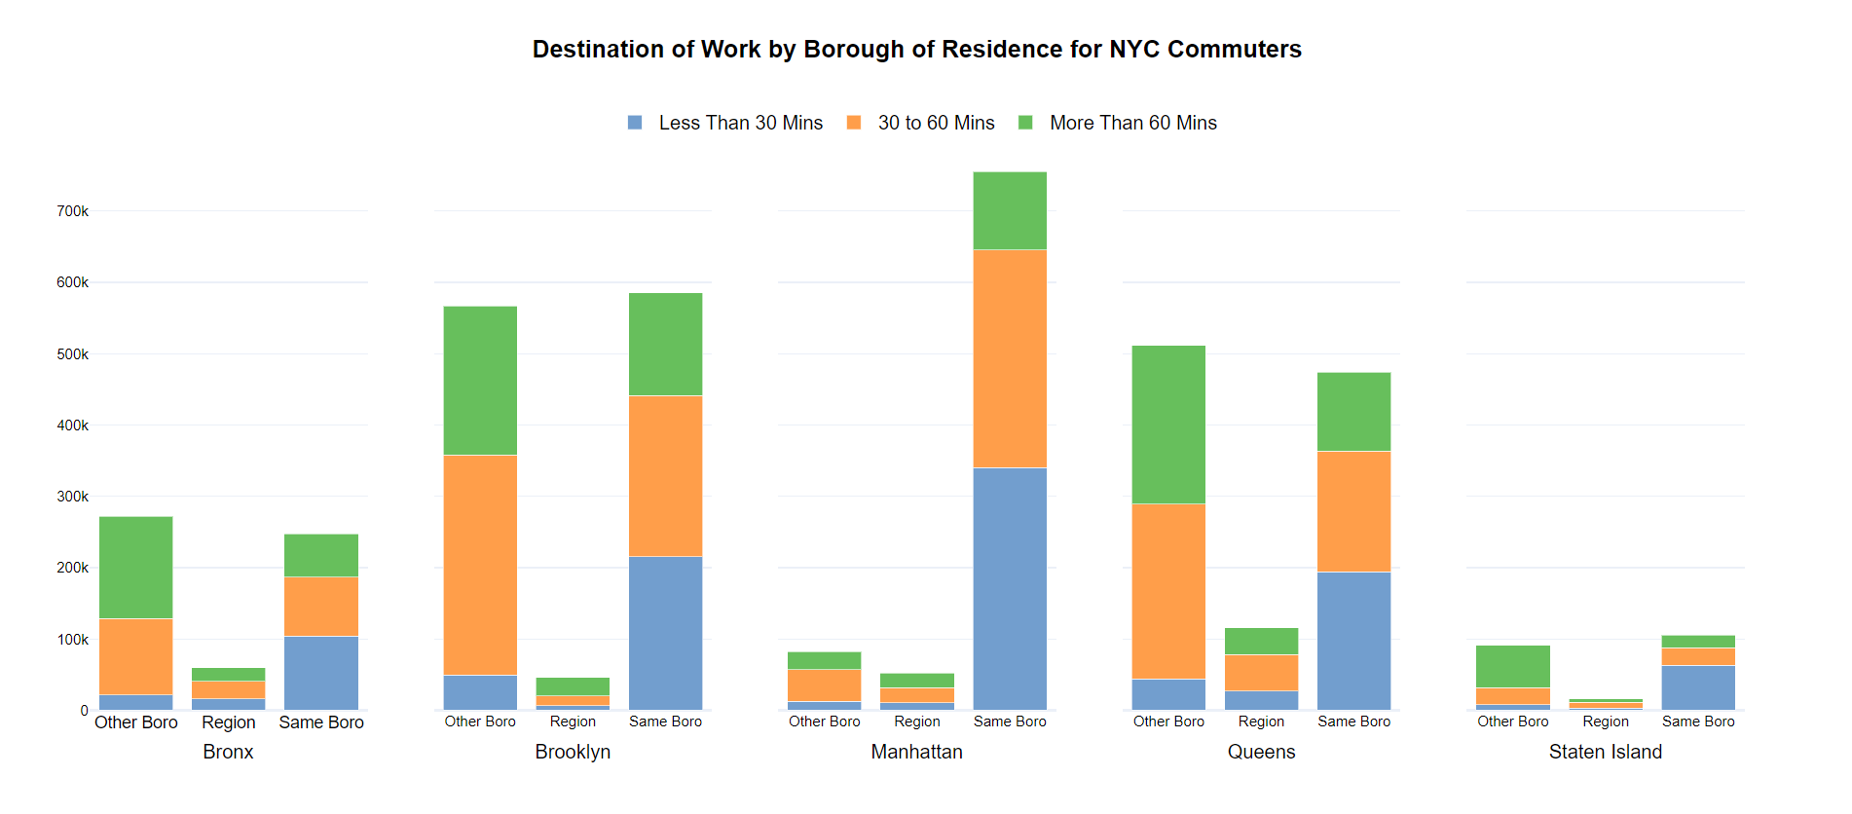
Plotly
Open-source data visualization tools
Creating interactive charts and maps
Multi-platform graphing libraries: Python, R, JavaScript, etc.
Dash for creating dashboards / apps
Hosting platform: GitHub Pages

Slide 10
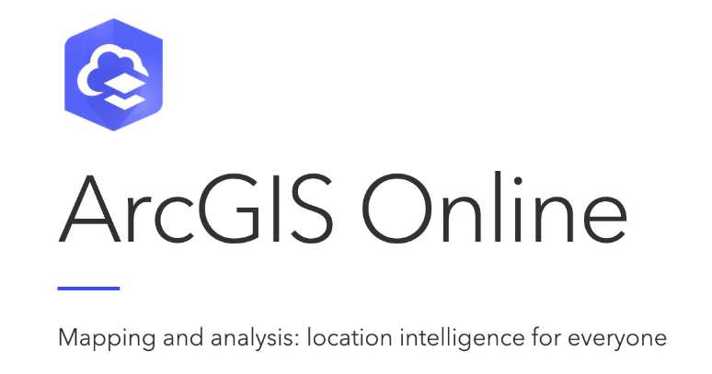

ArcGIS Online
Web-based mapping software by ESRI
Creating interactive charts, maps, dashboards, story maps, etc.
Using StoryMaps to organize final report with interactive charts / maps from other platforms embedded

Slide 11

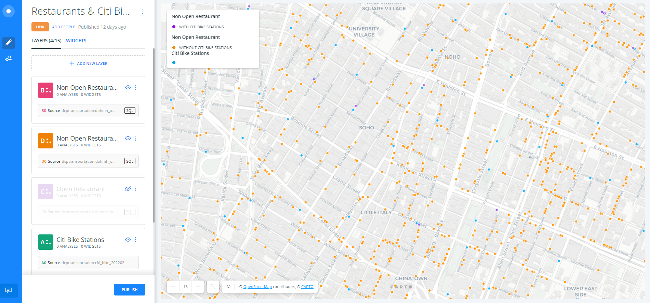
Carto
Web-based mapping platform
Storing geospatial data and creating interactive maps
Customization: SQL for data processing, CSS for styling, and HTML for legend editing

Slide 12

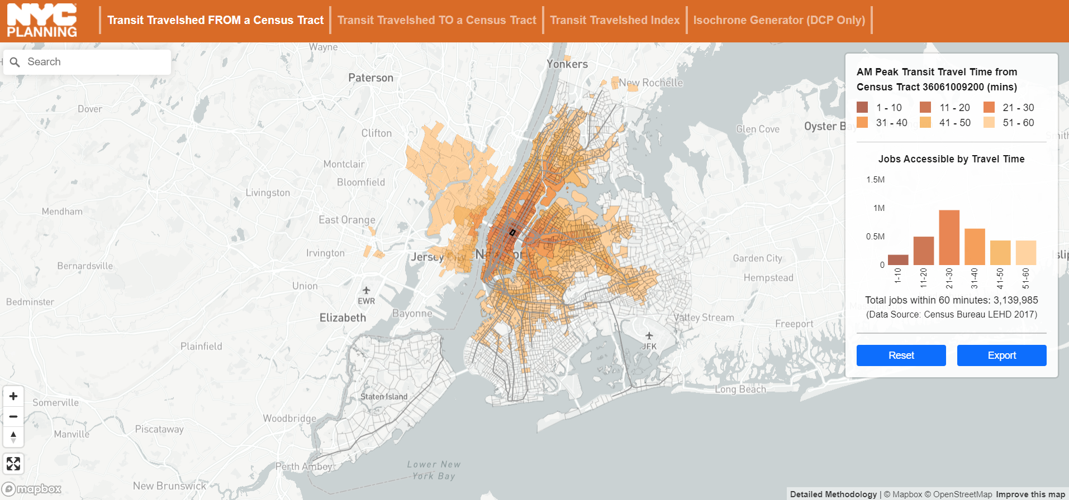
Mapbox GL JS
JavaScript mapping library
Creating interactive maps and highly customized web mapping apps
Editing tool: Visual Studio Code
Languages used: HTML, CSS, and JavaScript
Hosting platform: GitHub Pages

Slide 13


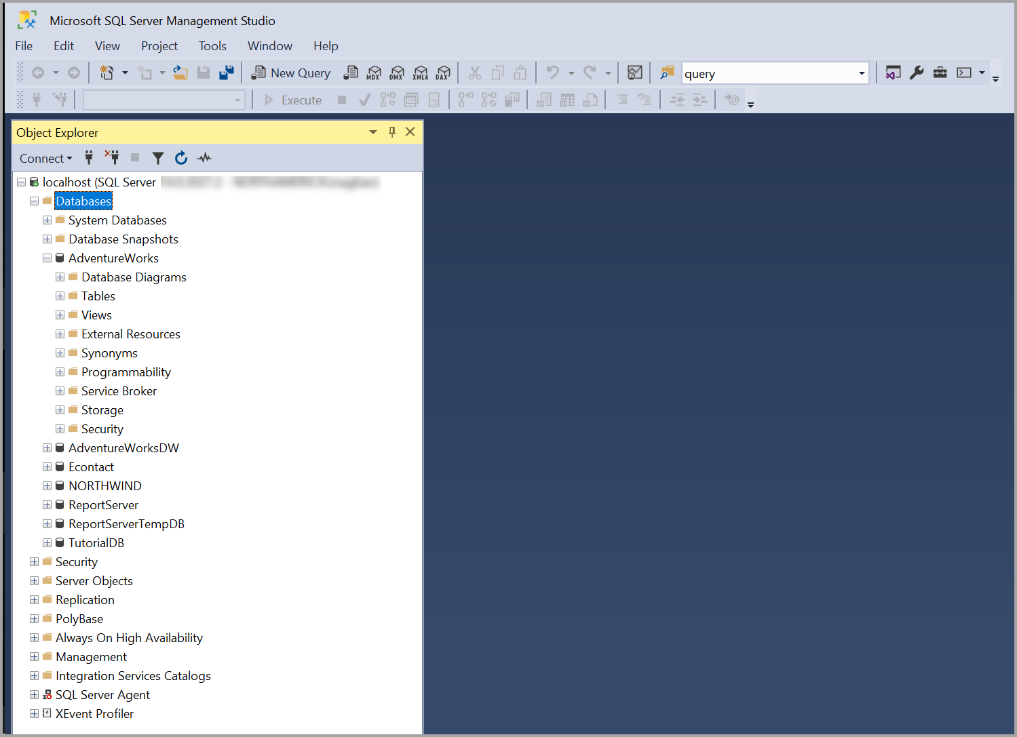
MS SQL Server
Commercial client/server relational database management system by Microsoft
Deployed and managed by ITD
Storing confidential datasets (TLC data)
Interface: SQL Server Management Studio / DBeaver

Slide 14
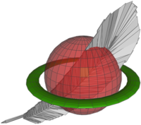

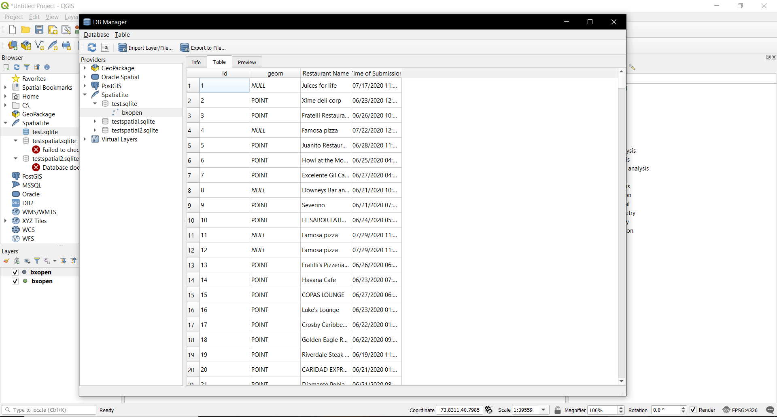
SQLite / SpatiaLite
SQLite: open-source file-based relational database management system
SpatiaLite: spatial extension to SQLite
Storing large public datasets into single database
Interface: DBeaver / QGIS

Slide 15


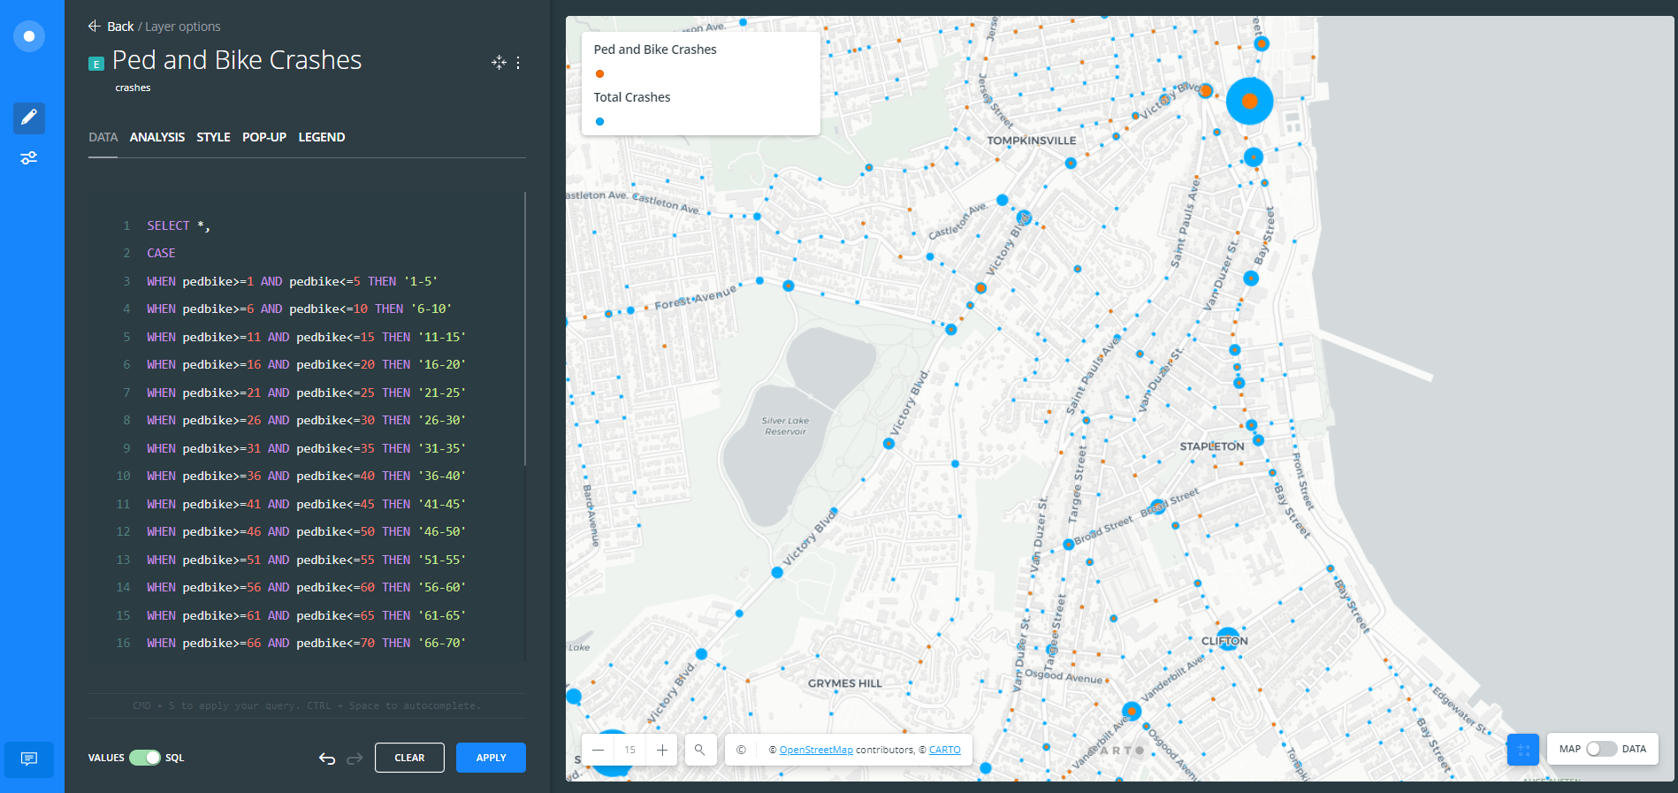
PostgreSQL / PostGIS
PostgreSQL: open-source client/server relational database management system
PostGIS: spatial extension to PostgreSQL
Storing spatial datasets
Interface: Carto

Slide 16

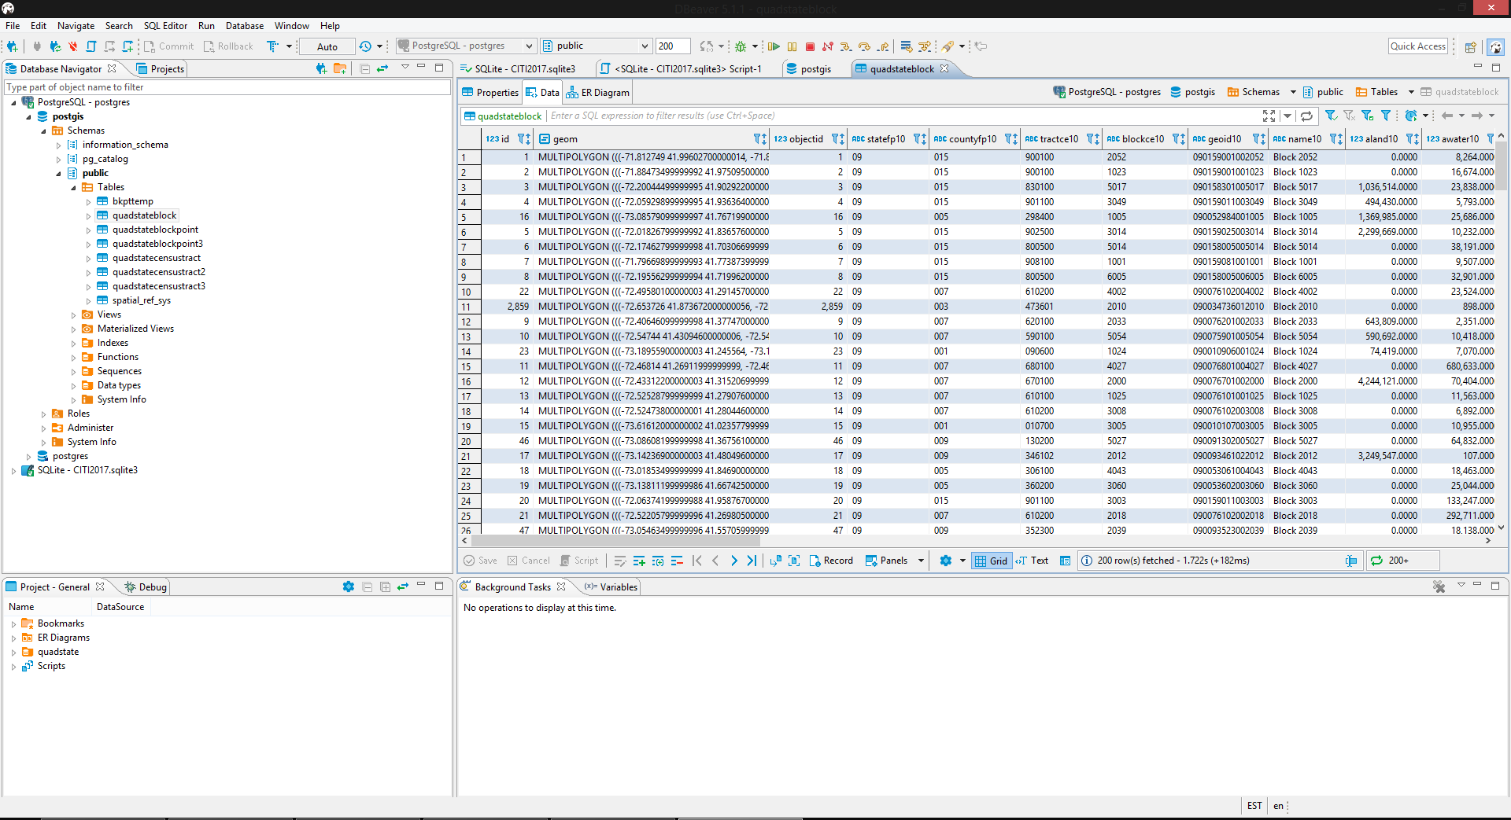
DBeaver
Open-source database administration tool
Supports CSV, MS SQL Server, SQLite, PostgreSQL, MySQL, Oracle, IBM DB2, MS Access, etc.

Slide 17

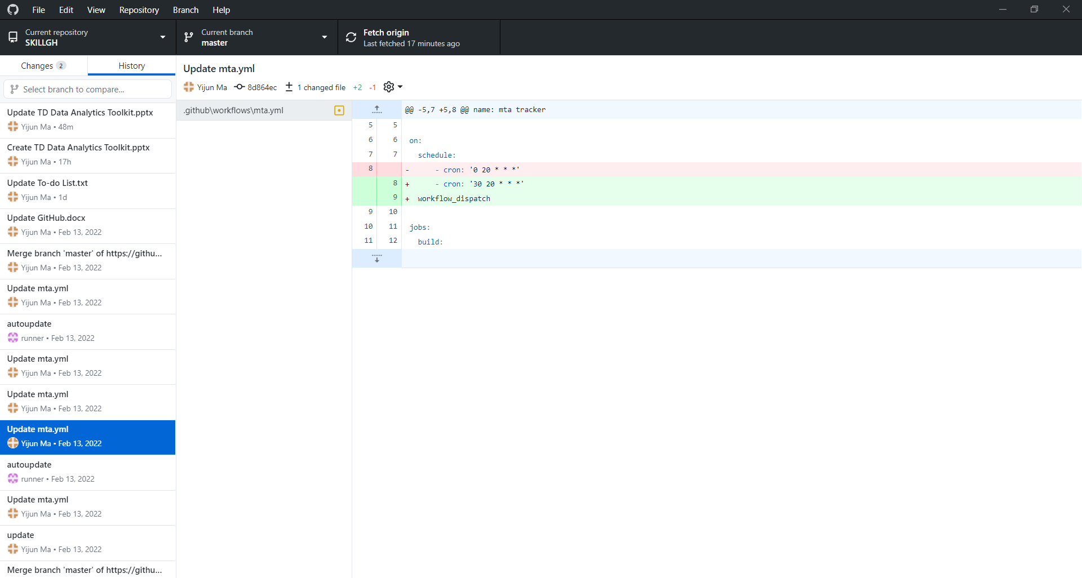
GitHub
Version control and source code management platform
Storing scripts, hosting web apps, automating updates, etc.
GitHub Desktop: simple tool to pull and push scripts to the cloud
GitHub Pages: place to host interactive charts / maps and web apps for public sharing
GitHub Actions: tool to automate the workflows and update the data regularly

Slide 18

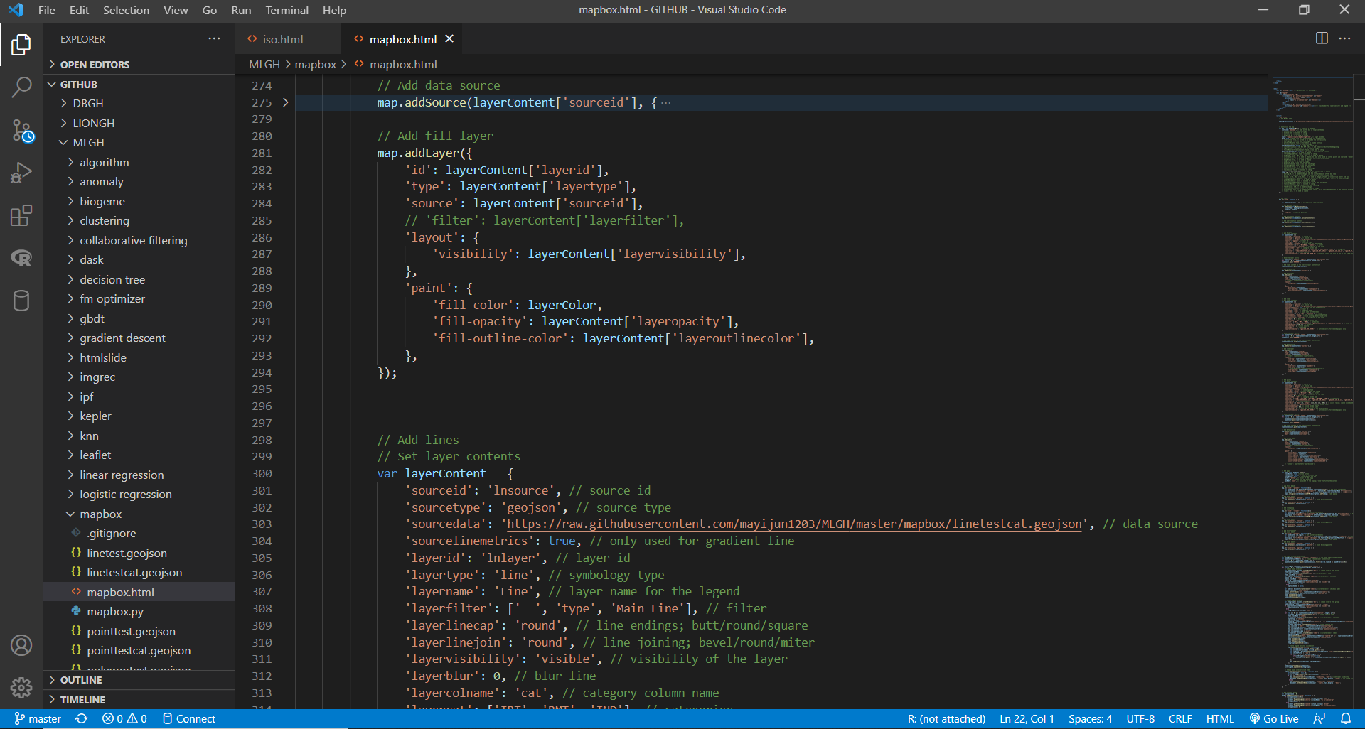
Visual Studio Code
Source code editor developed by Microsoft
Editing scripts for creating web apps and testing the apps locally
Supported languages: HTML, CSS, JavaScript, SQL, Python, R, etc.

Slide 19

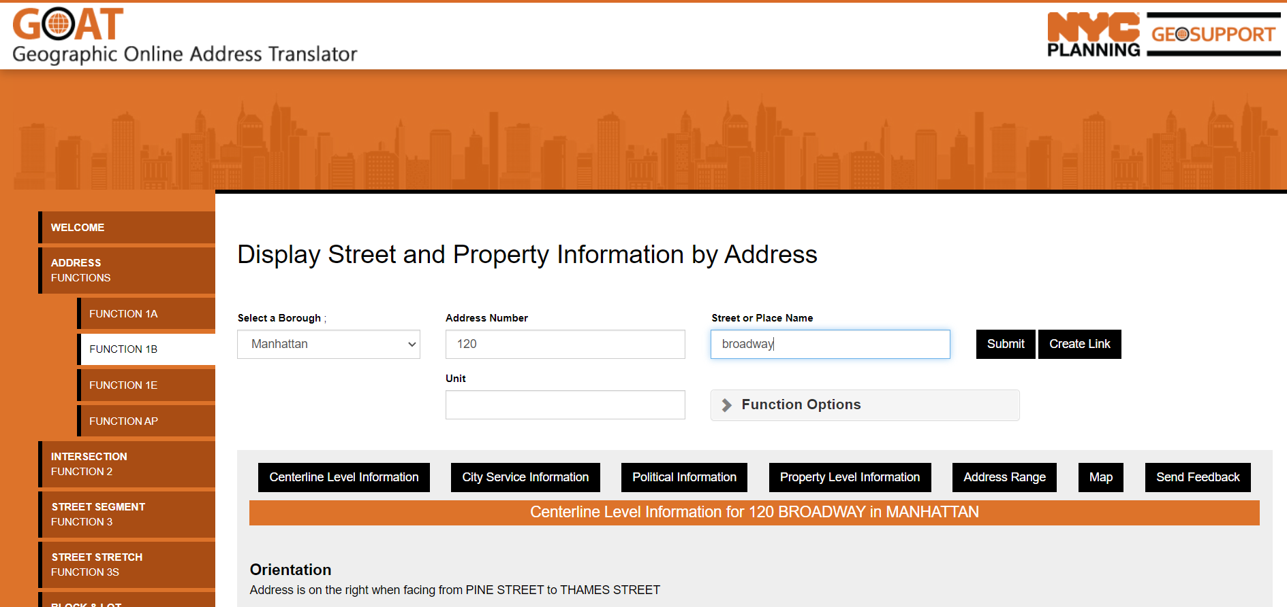
Geosupport
Geocoding package for NYC addresses
GOAT: web app for geocoding individual address
GBAT: batch geocoding multiple addresses
Geoclient (DOITT) / Geoservice (DCP): geocoding API
Python-Geosupport: python package to geocode large datasets (especially confidential data)

Slide 20

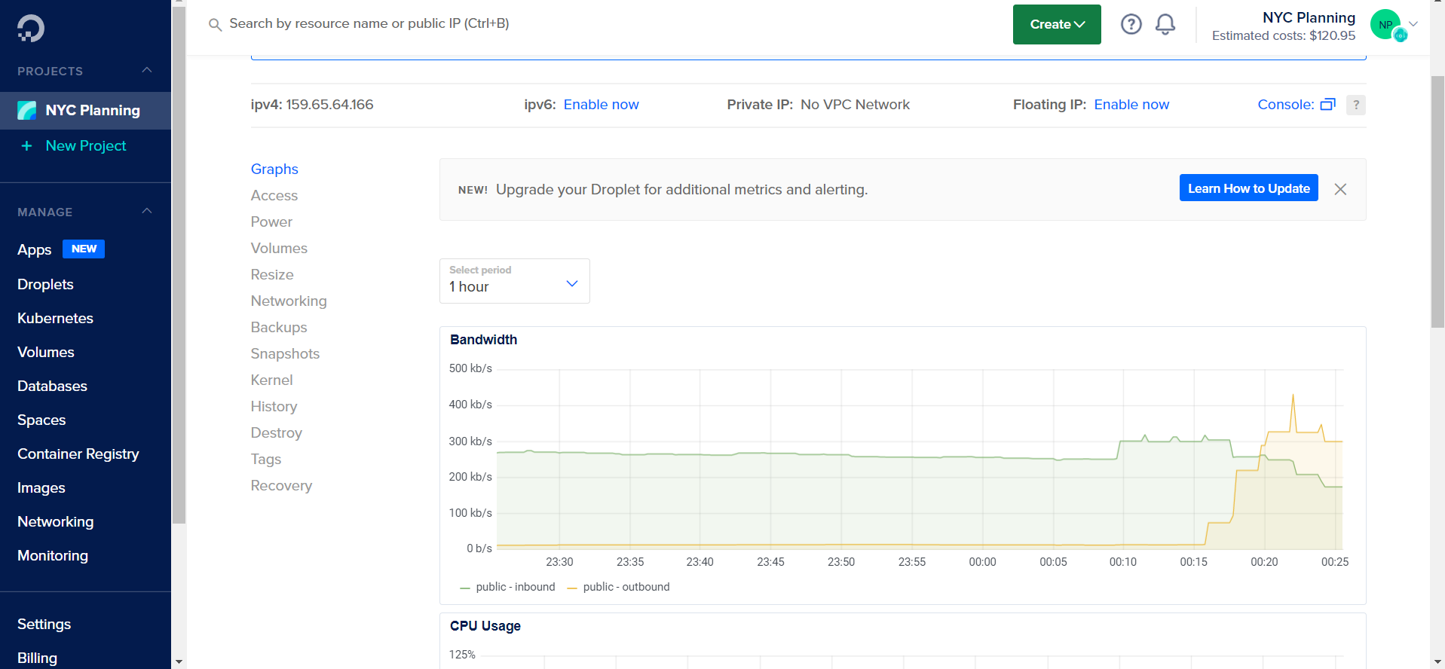
DigitalOcean
Cloud computing service provider
Streaming data, processing massive datasets, hosting web service, etc.
Connection tool: PuTTY / SSH
Data transfer tool: WinSCP / Cyberduck

